Slide 1
Summer internship Overview
Stimulating States of Parkinsonian Tremor
Cagnan Group
Presented by: Muhammad Roshan Mughees
Supervisor: Dr. Tim West

Slide 2

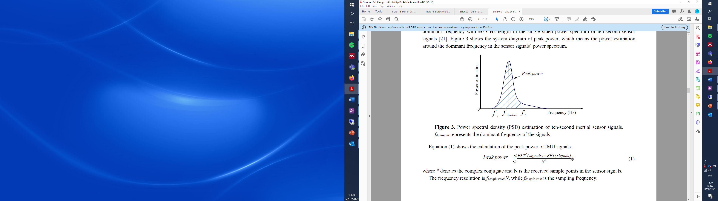
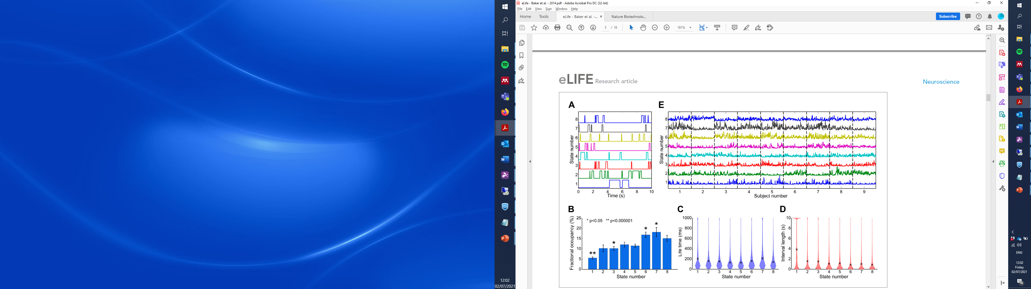
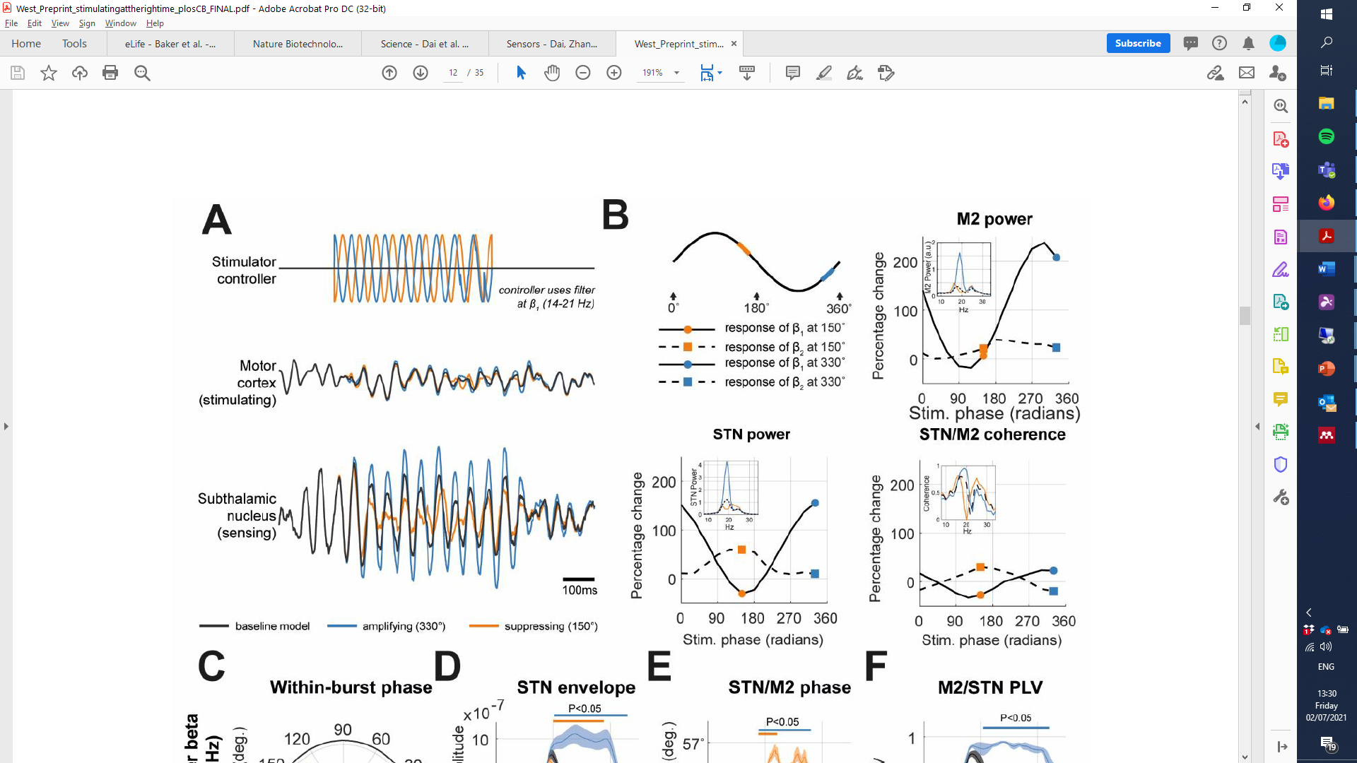
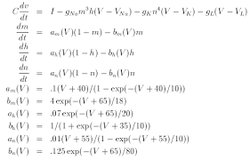
Familiarize with data. Preprocessing and quality control
1
2
Look for variation in tremor expression and build up a set of states
4
3
Model stimulation
Fit models of tremor generation to the data, building a model for each state.
Notes:
2 = they are taking our resting state networks. When you stay still, different states in your brain engage and can be seen by MRI
3 = using states, we can fit these models of tremor. How detailed will be discussed later
4 = fit model to each of the states and then use stimulation to suppress the tremor

Slide 3
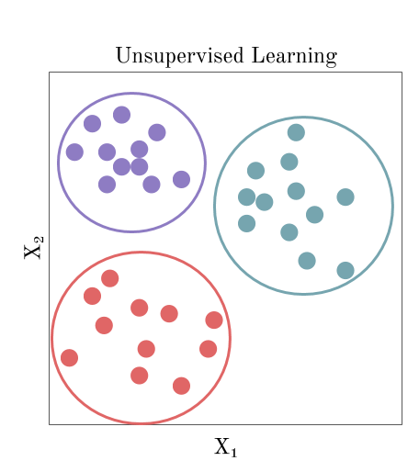
Sample
1
2
3
4
5
Unsupervised classification
Class (states)
1
1
2
1
3
Tremor features
State1
State2
State 3
Average features
Inverse Modelling
Mechanistic models of tremor generation
M1
M2
M3
Notes:
We can find mapping of stimulation to each state.
Some clusters will represent different types of tremors and some will represent more healthy state with less tremor

Slide 4
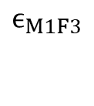
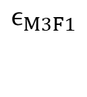
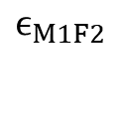
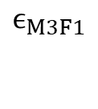
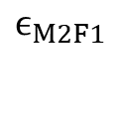
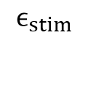
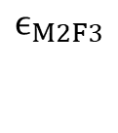
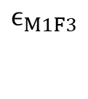
Stimulation parameters
$$ϵ_{stim}$$
“Trem state 1”
“Trem state 2”
“no tremor”
Phase
Frequency
Amplitude
M1
M2
M3
$$ϵ_{M1F3}$$
F1
$$ϵ_{M2F1}$$
$$ϵ_{M3F1}$$
M1
Stim
M3
F1
F3
F2
$$ϵ_{M1F2}$$
$$ϵ_{M3F1}$$
Find stimulation mapping from state to state
F3
$$ϵ_{M1F3}$$
$$ϵ_{M2F3}$$
Need to find/learn transition matrix

Slide 5
Thank you for providing me the opportunity! Any Questions?

